Slide 1
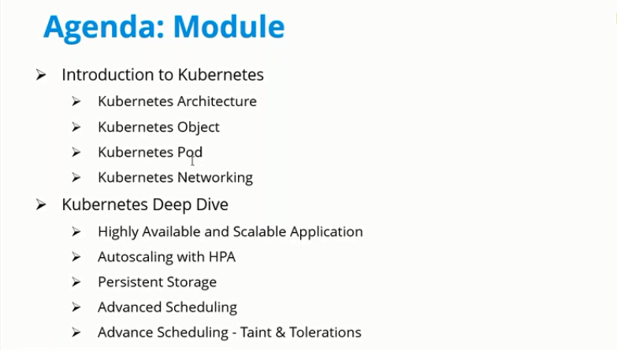

Slide 2
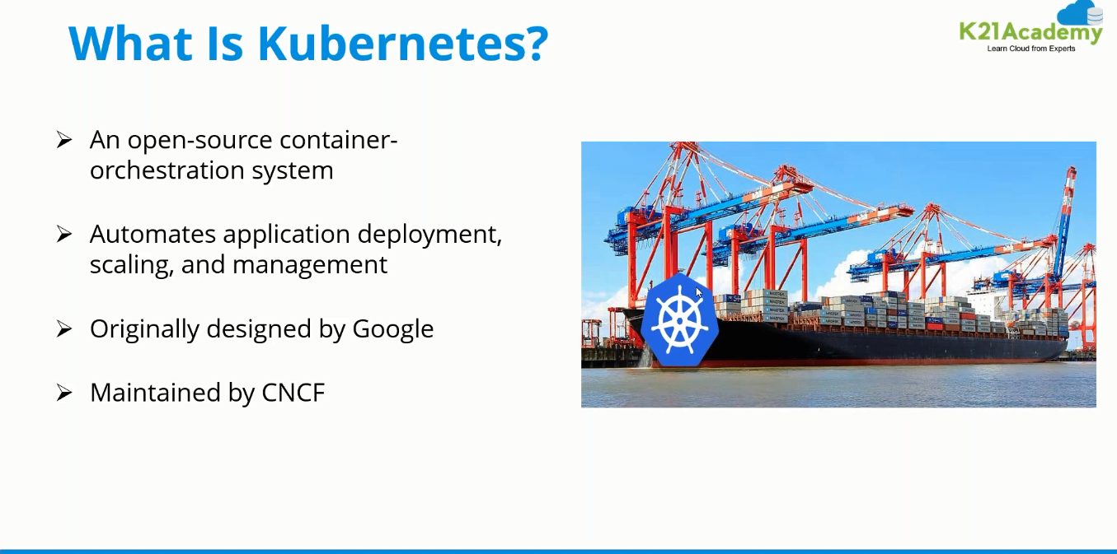

Slide 3
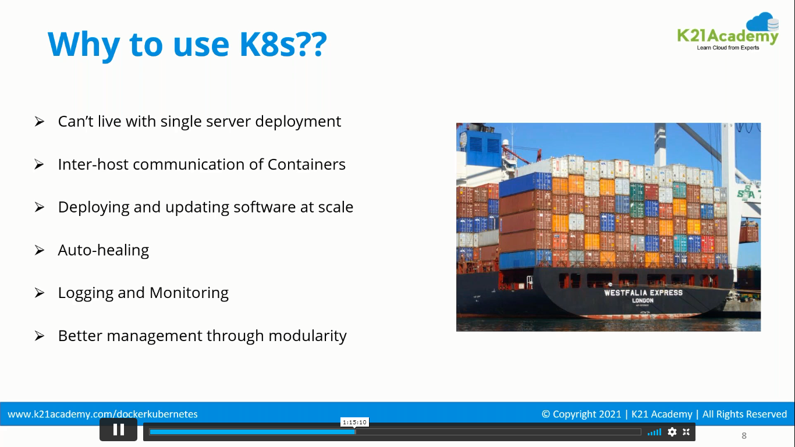

Slide 4
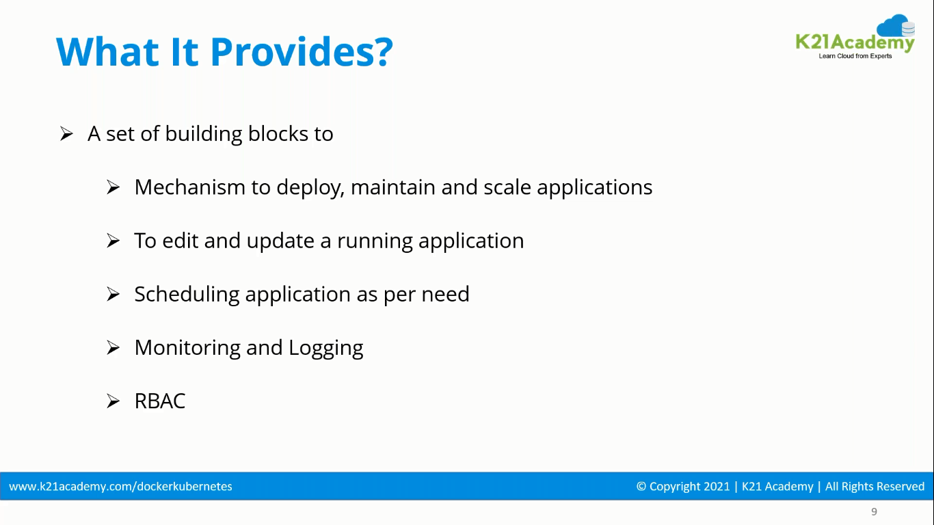

Slide 5
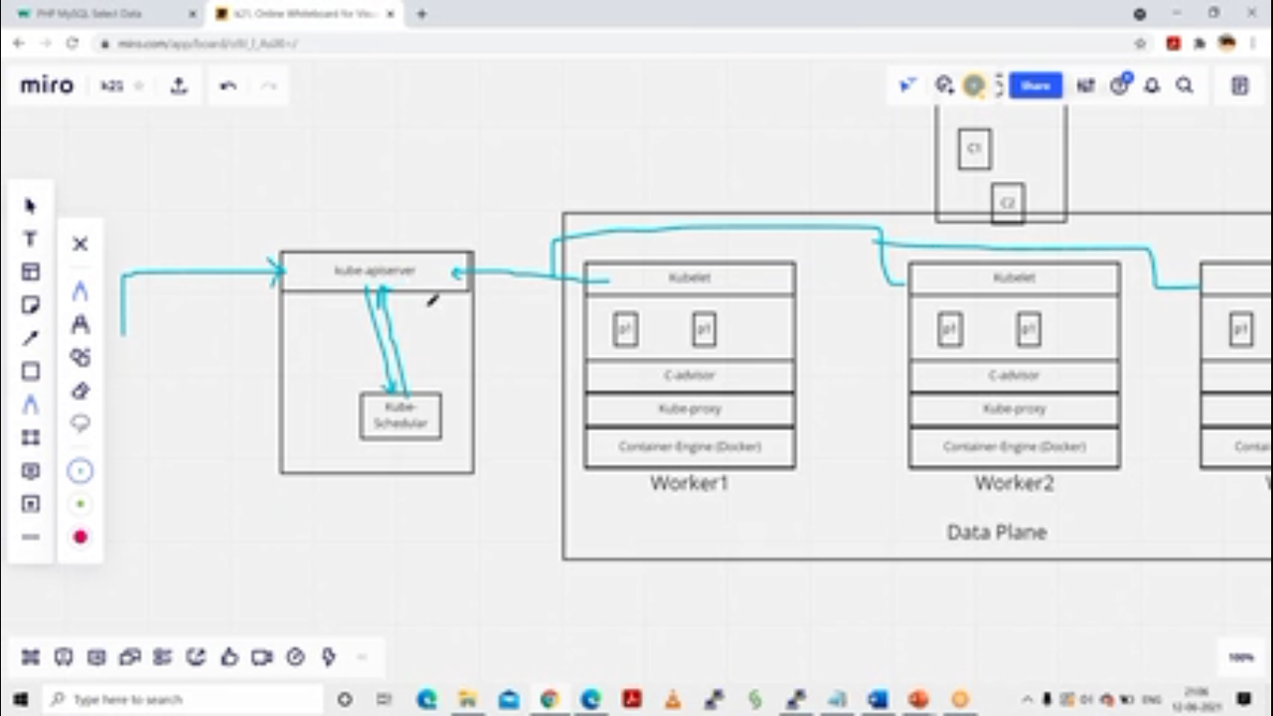

Slide 6
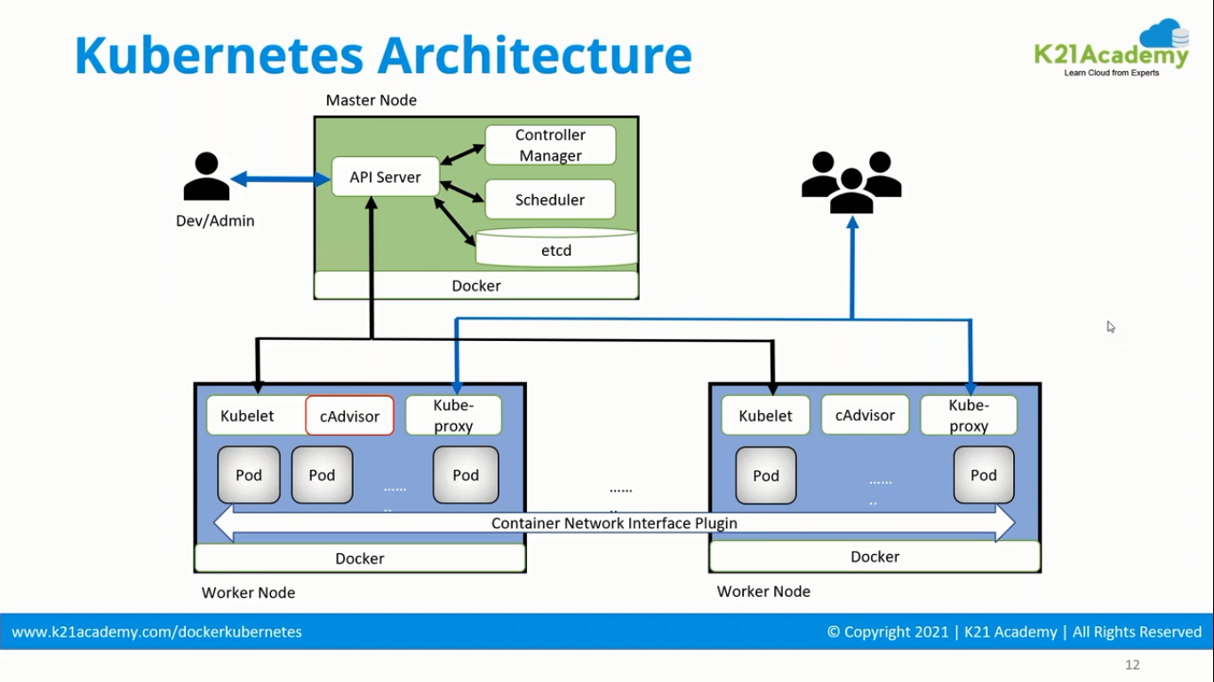

Slide 7
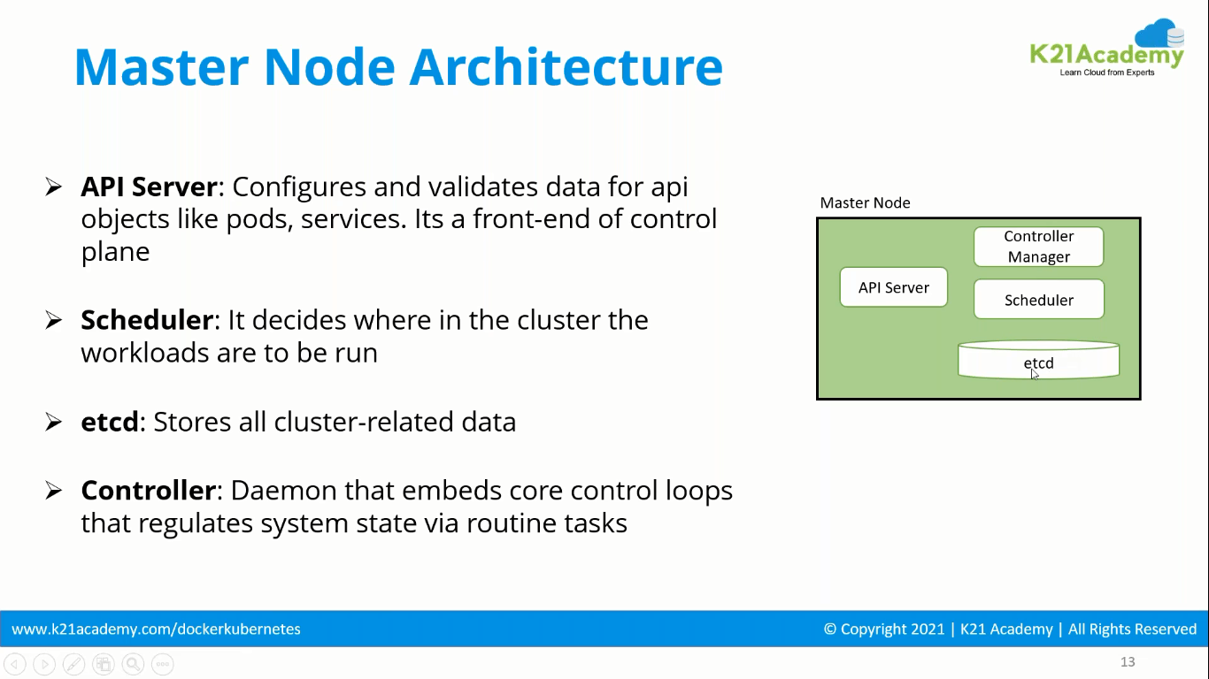

Slide 8
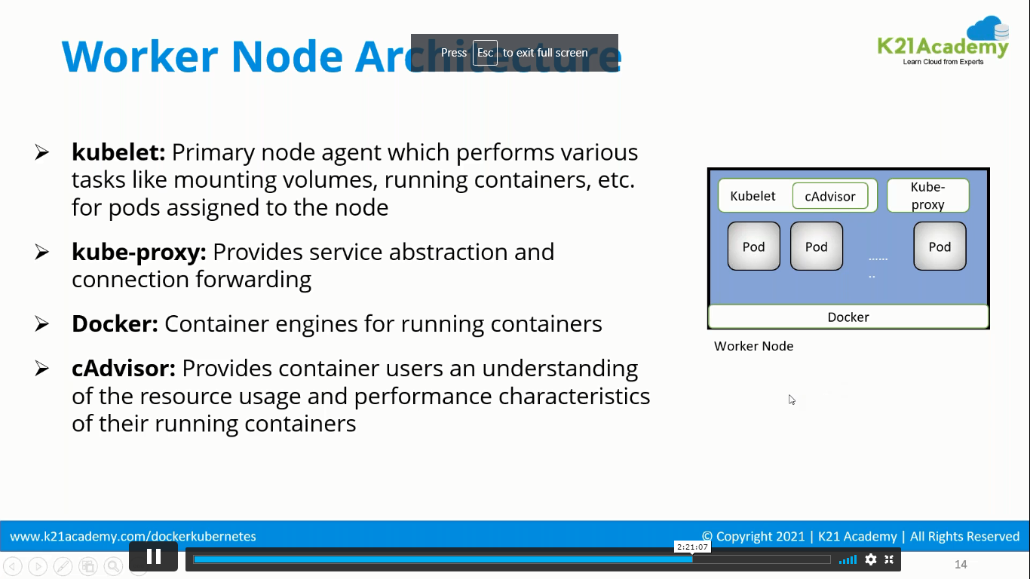
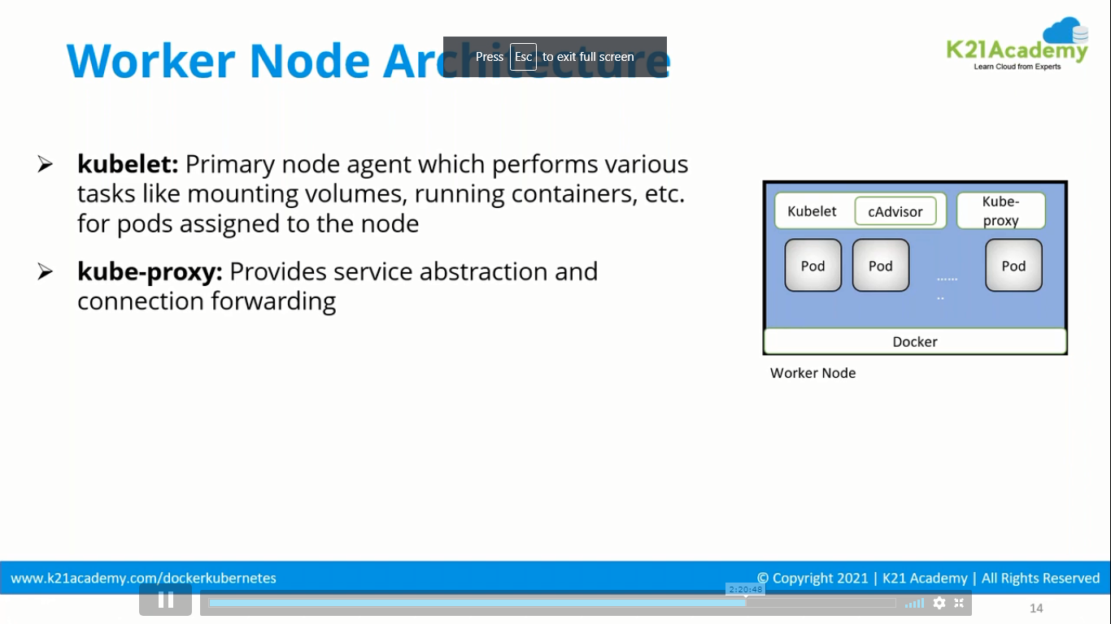

Slide 9
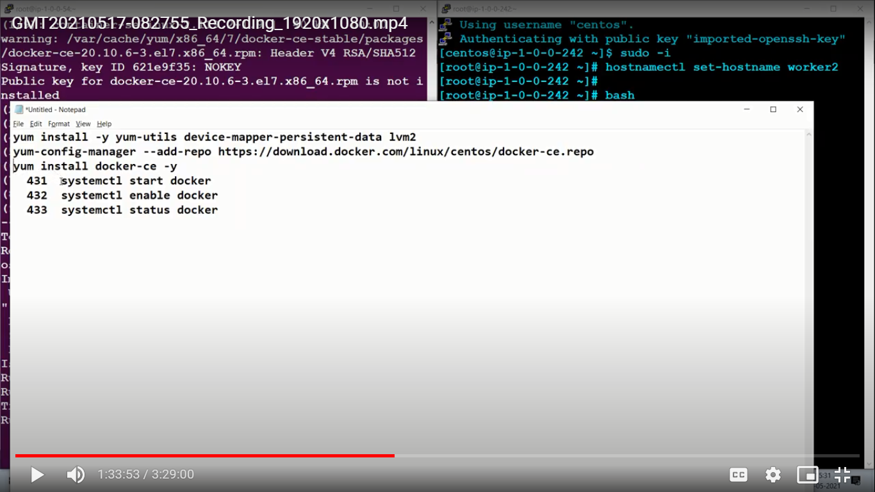

Slide 10
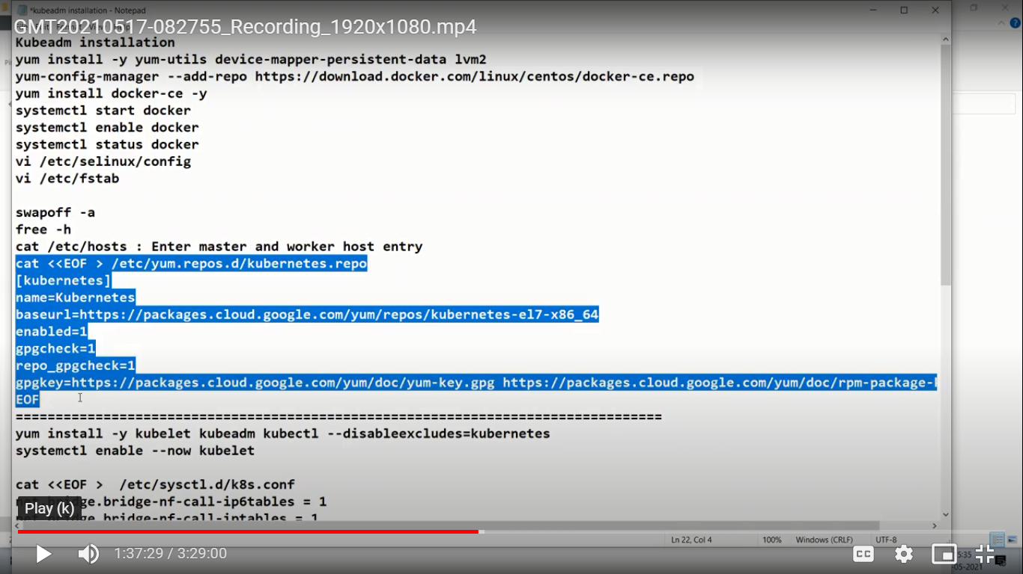

Slide 11
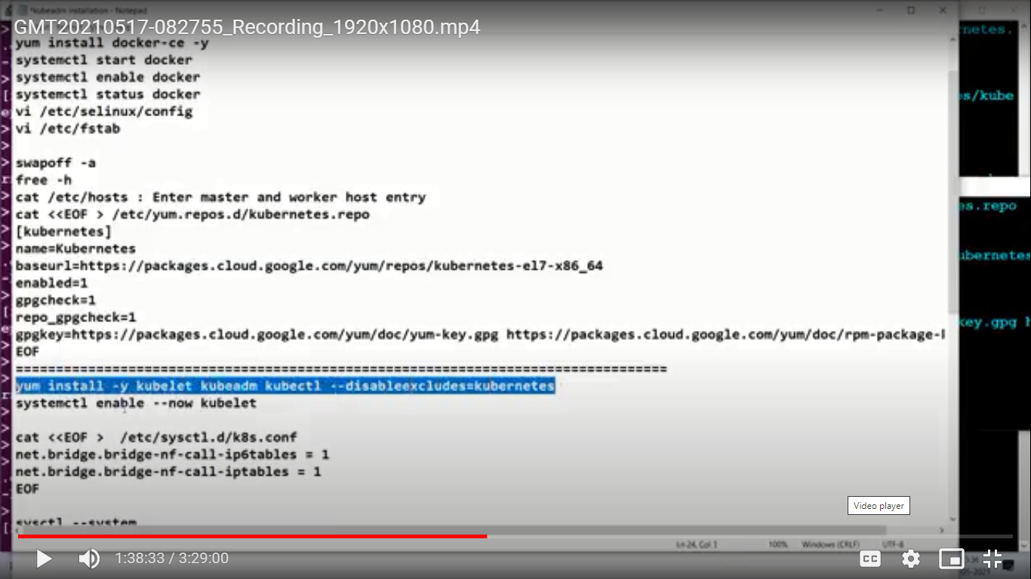

Slide 12
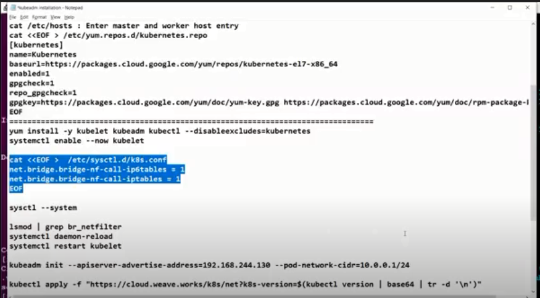

Slide 13
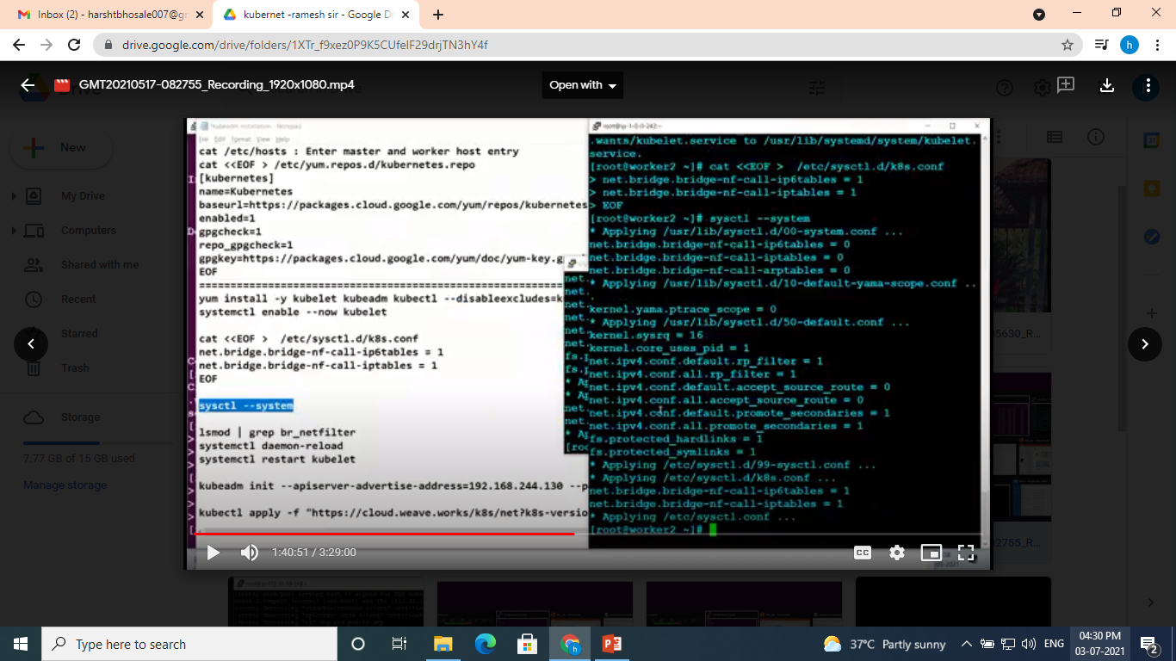

Slide 14
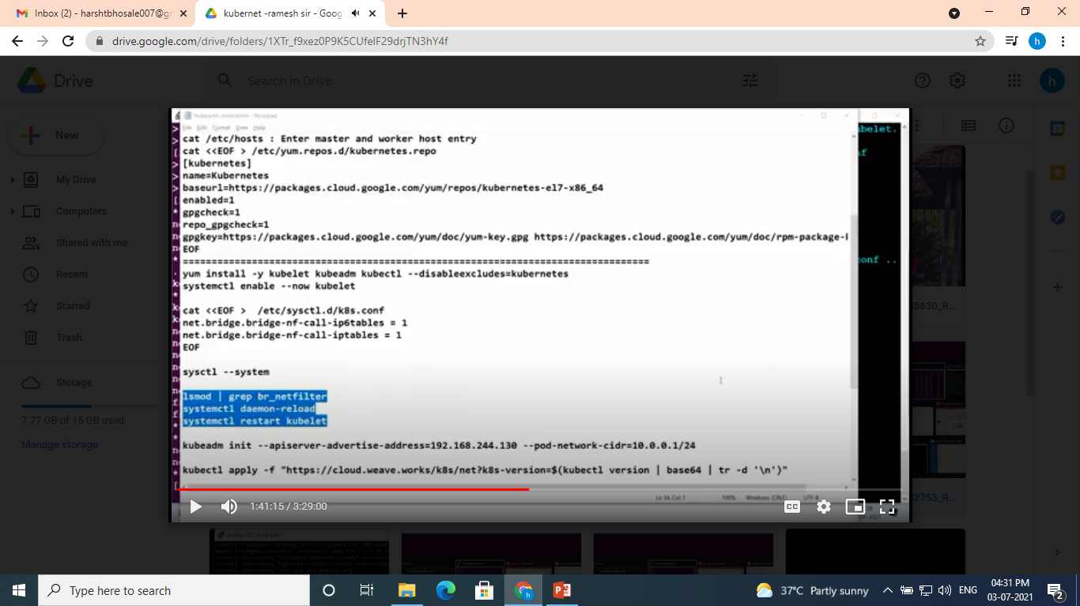

Slide 15
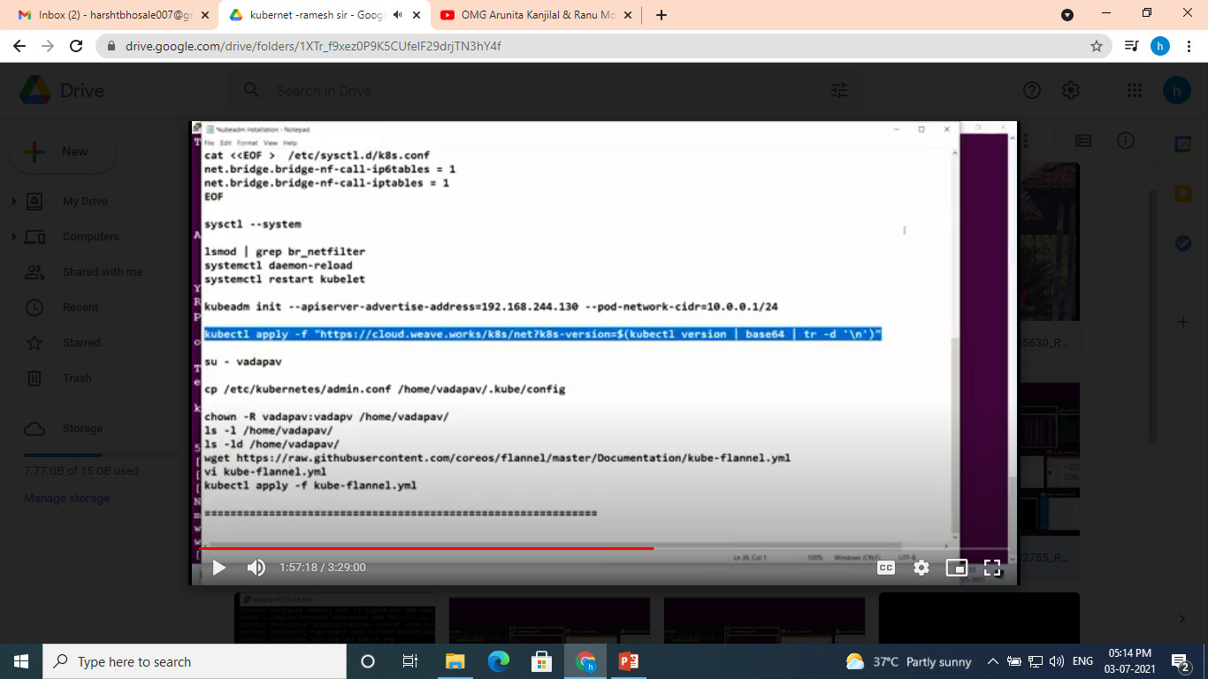

Slide 16
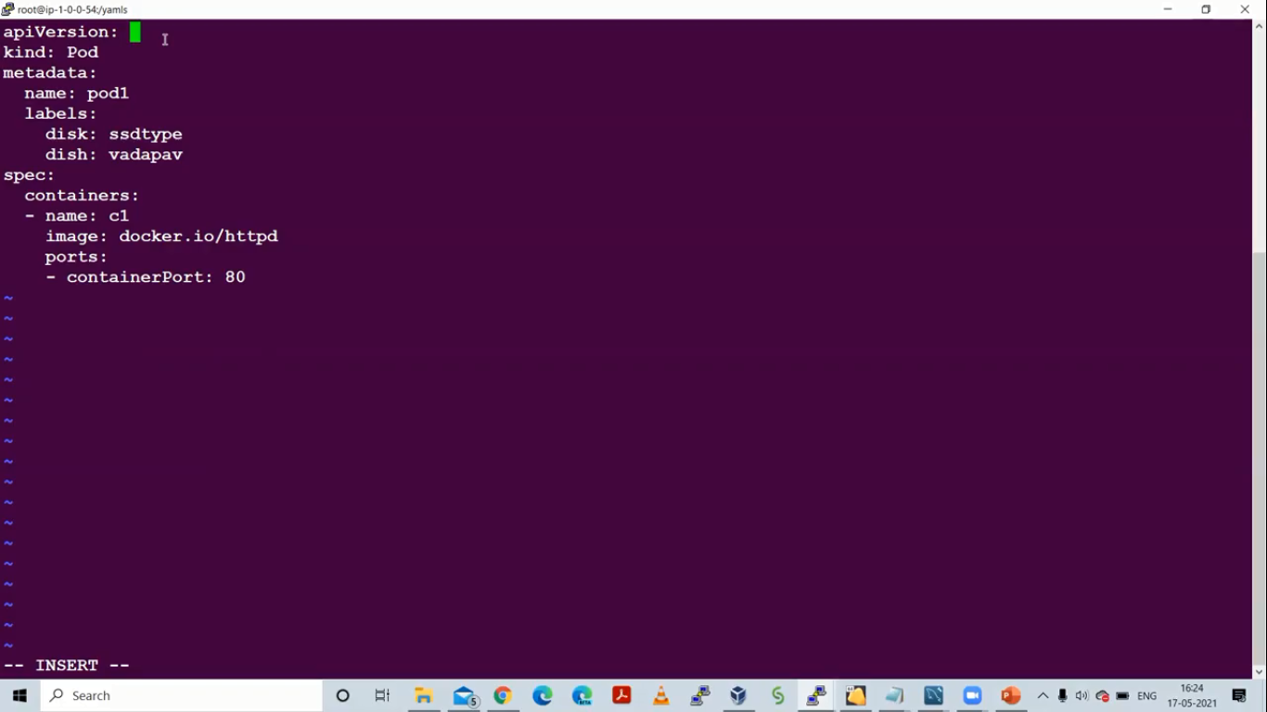
Yaml file to create pod

Slide 17
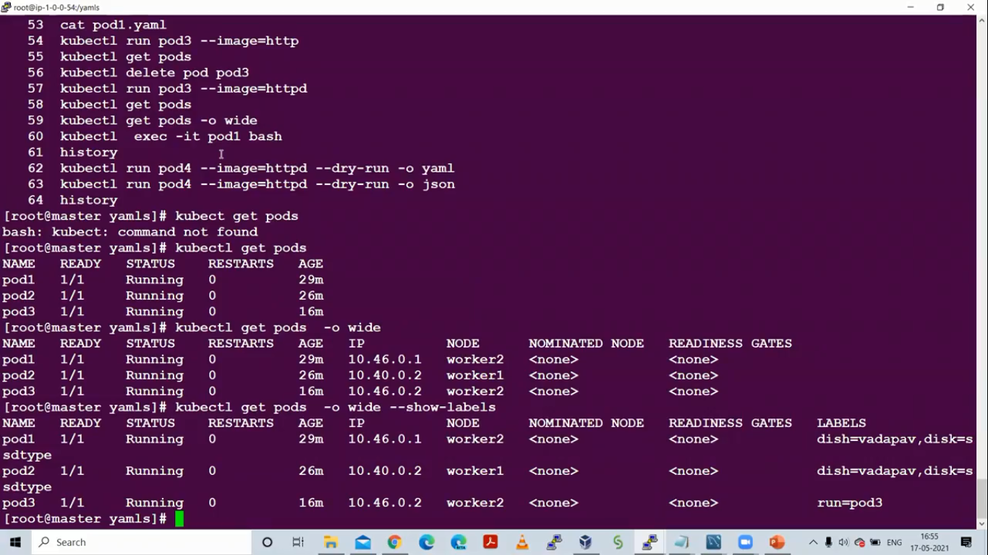

Slide 18
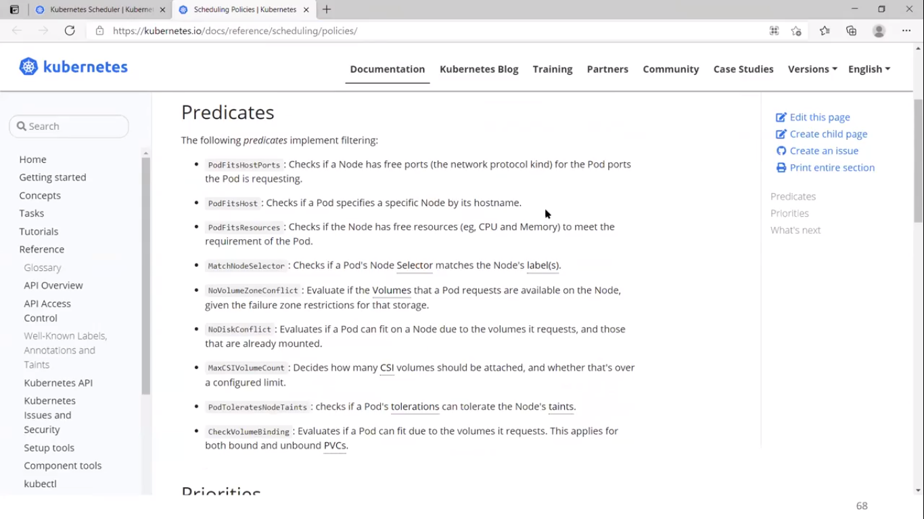

Slide 19
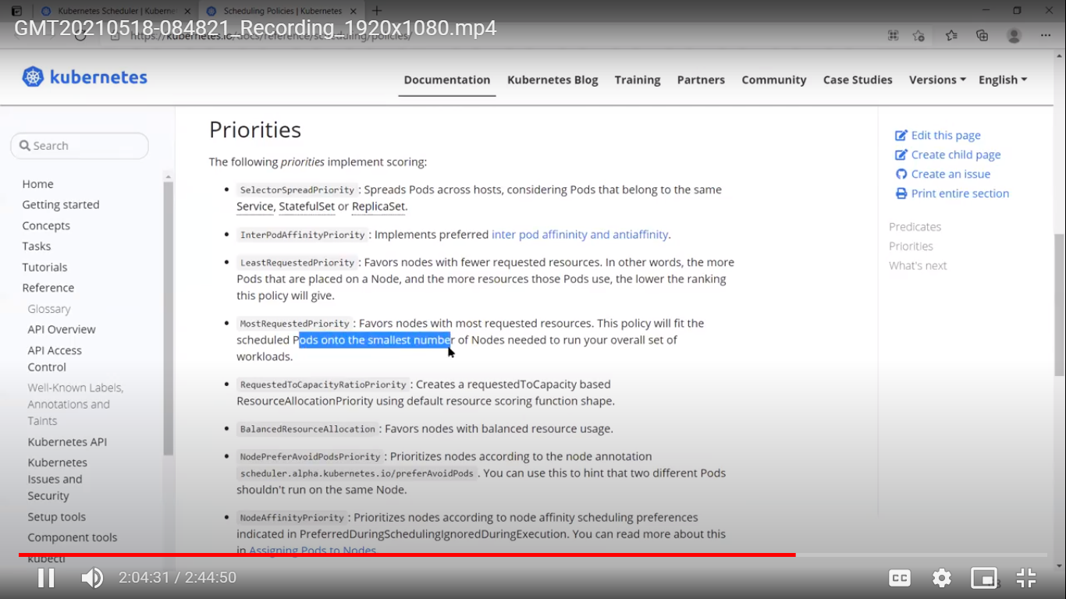

Slide 20
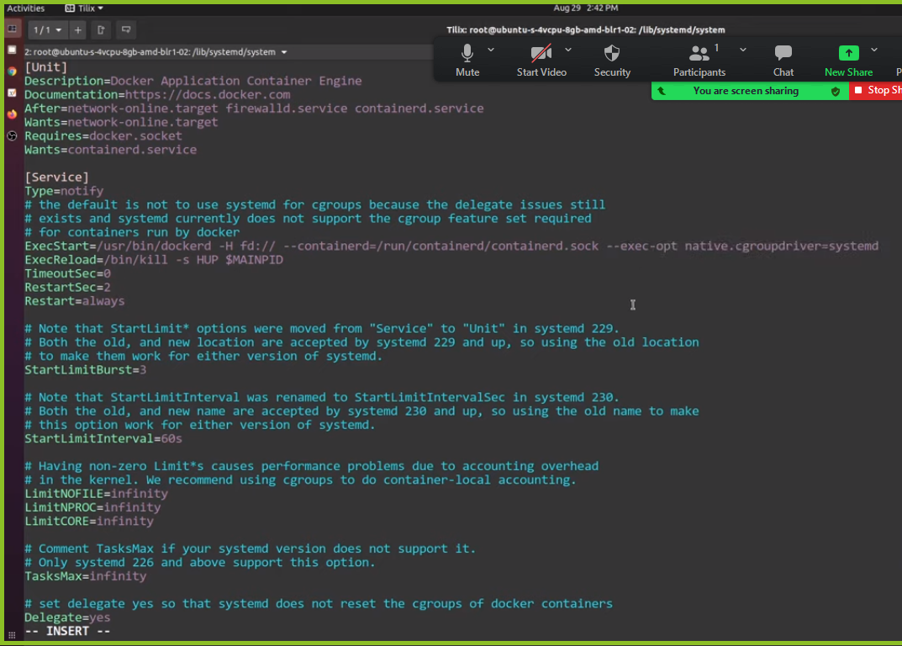
This line will conver cgroup to systemd
Update on master , and on worker node

Slide 21
Setting up three node Kubernetes cluster
First of all, we should have three instances created that can connect over the public network. It doesn't matter how those instances are created, for example, they can either be Digital Ocean droplets or AWS EC2 instances.
SSH into all the instances
Once you are into those instances, the commands that are mentioned below should be run on all the instances
Commands to run on all the nodes
# Get sudo working sudo -l # update packages and their version sudo apt-get update && sudo apt-get upgrade -y # install curl and apt-transport-https sudo apt-get update && sudo apt-get install -y apt-transport-https curl # add key to verify releases curl -s https://packages.cloud.google.com/apt/doc/apt-key.gpg | sudo apt-key add - # add kubernetes apt repo cat <<EOF | sudo tee /etc/apt/sources.list.d/kubernetes.list deb https://apt.kubernetes.io/ kubernetes-xenial main EOF # install kubelet, kubeadm and kubectl sudo apt-get update sudo apt-get install -y kubelet kubeadm kubectl # install docker sudo apt-get install docker.io # apt-mark hold is used so that these packages will not be updated/removed automatically sudo apt-mark hold kubelet kubeadm kubectl
After the above commands are successfully run on all the worker nodes. Below steps can be followed to initialize the Kubernetes cluster.
On Leader Node
Run the below command on the node that you want to make the leader node. Please make sure you replace the correct IP of the node with IP-of-Node
export MASTER_IP=<IP-of-Node> kubeadm init --apiserver-advertise-address=${MASTER_IP} --pod-network-cidr=10.244.0.0/16
Join worker nodes to the Leader node
Once the command kubeadm init is completed on the leader node, below we would get a command like below in the output of kubeadm init that can be run on worker nodes to make them join the leader node.
kubeadm join 206.189.134.39:6443 --token dxxfoj.a2zzwbfrjejzir4h \ --discovery-token-ca-cert-hash sha256:110e853989c2401b1e54aef6e8ff0393e05f18d531a75ed107cf6c05ca4170eb
Install CNI plugin
The below command can be run on the leader node to install the CNI plugin
kubectl apply -f https://raw.githubusercontent.com/coreos/flannel/master/Documentation/kube-flannel.yml

Slide 22
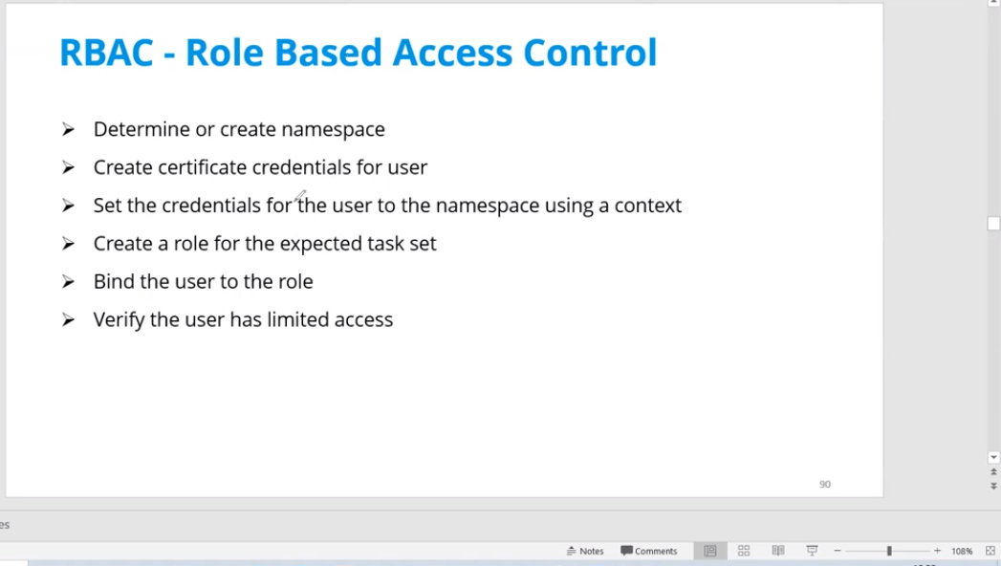

Slide 23
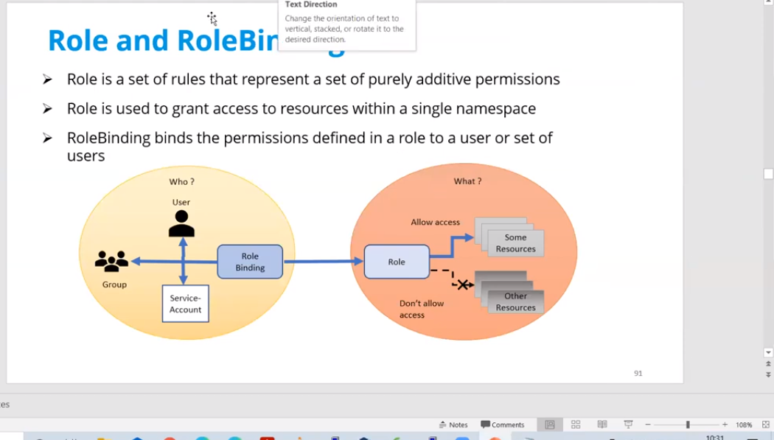

Slide 24
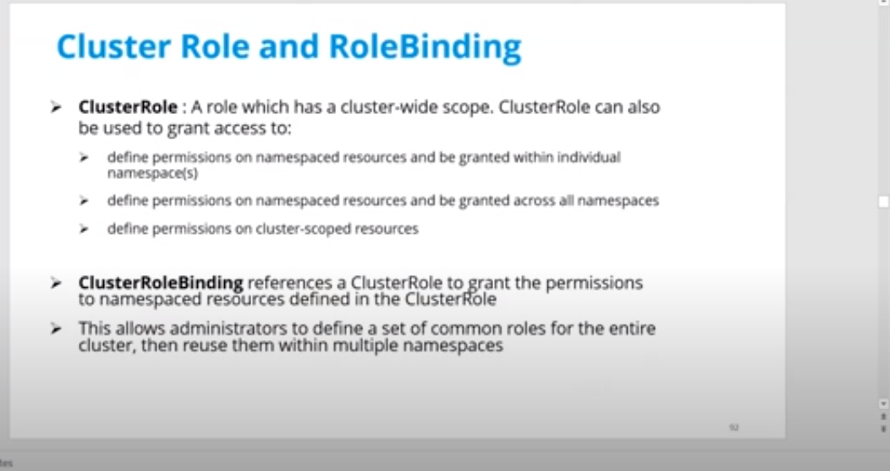

Slide 25
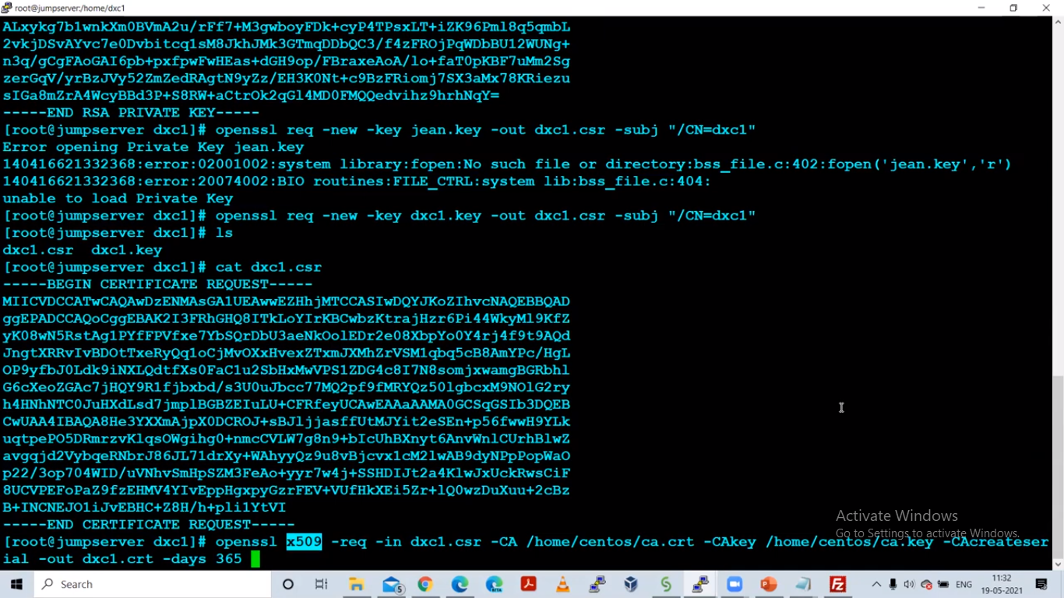
For user
RBAC
Refer book
Notes also

Slide 26
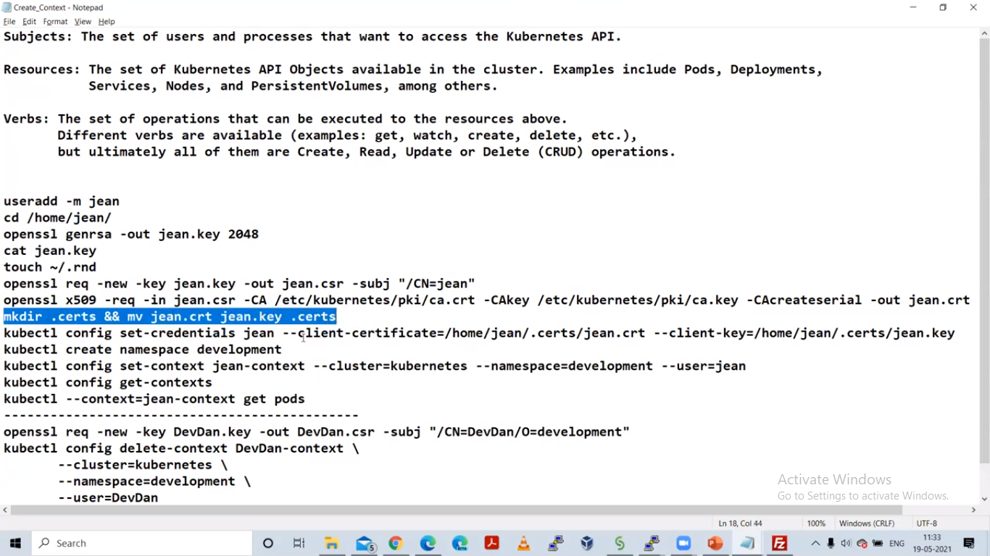

Slide 27
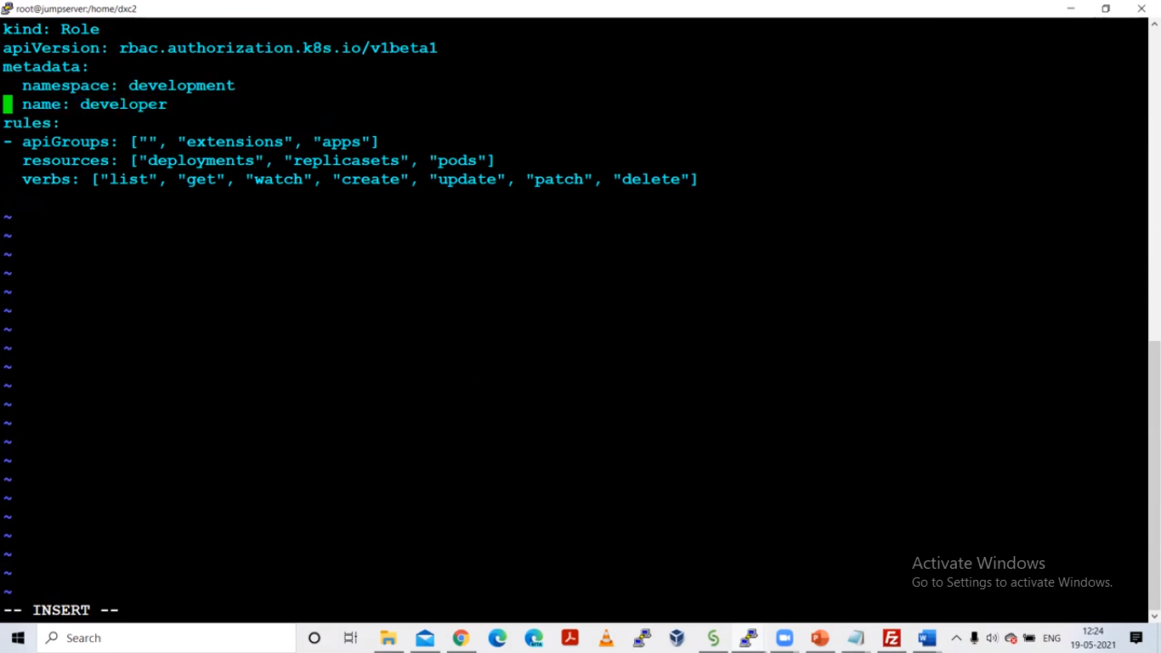
Yaml file for
role

Slide 28
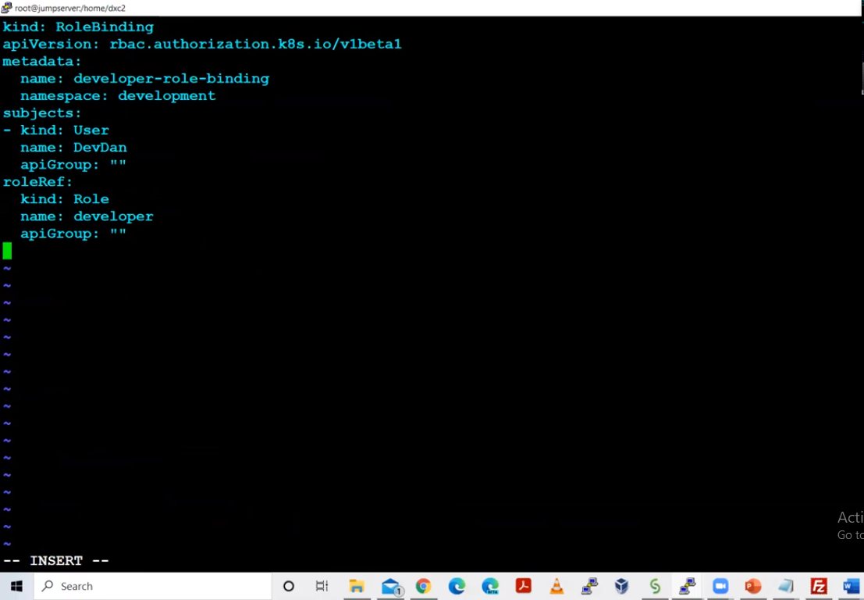
Role binding
yaml file

Slide 29
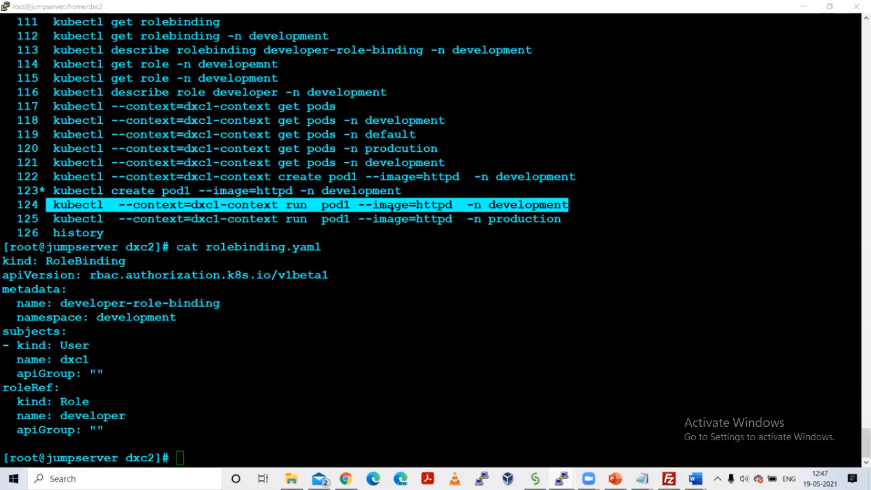
All command histroy

